Slide 1



HR DATA
PROJECT
Presentation by Team 1 (ONL2_DAT2_S5)

Slide 2


MEET THE GROUP
Samar Wagih
Ahmed Yasser
Omar Magdy
Menna Allah Abdul-Majeed
Kyrollos Nader

Slide 3
PROBLEM BEING SOLVED
Organizations often face challenges in understanding the reasons behind employee attrition. With large volumes of HR data, it becomes difficult to identify the key drivers of employee turnover.
High attrition leads to talent loss, increased costs, and reduced efficiency.
This project focuses on analyzing employee data to better understand the patterns and factors associated with attrition, with the goal of supporting more informed HR decisions.

Slide 4
Our Data
The dataset used in this project is provided by the Digital Egypt Pioneers Initiative (DEPI) as part of a graduation project.
It includes multiple tables related to employee demographics, satisfaction, education, and performance—used to analyze workforce dynamics and attrition trends.
Main Tables:
Employee
SatisfiedLevel
EducationLevel
PerformanceRating
RatingLeve

Slide 5
Proposed Solution
We designed an interactive, multi-page HR dashboard using Power BI to centralize and visualize key workforce metrics. The dashboard provides a comprehensive view of employee attrition patterns, satisfaction levels, and demographic insights to support data-driven HR decisions.
As an added value, a complementary Tableau dashboard was also developed to demonstrate versatility in visual analytics and enhance exploratory capabilities.

Slide 6
Data cleaning
Review Data Validation and Consistency
Feature Engineering: To enhance the dataset for analysis, the following features were engineered:
Leaving Date
Tenure Classification
Salary Classification
Satisfaction and Balance Columns
Age Classification
Distance from Home Classification
First Year Promotion Employees
Tools and Technologies:
Power BI and Tableau

Slide 7
Guiding Questions
We structured our exploration around a set of guiding questions:
What factors increase the likelihood of employee attrition?
How do overtime and salary levels relate to turnover?
Does tenure or early promotion influence retention?
What role do stock options and work-life balance play?
Are younger employees progressing into leadership?
How do hiring trends affect organizational diversity?

Slide 8
Our Data Model

Slide 9
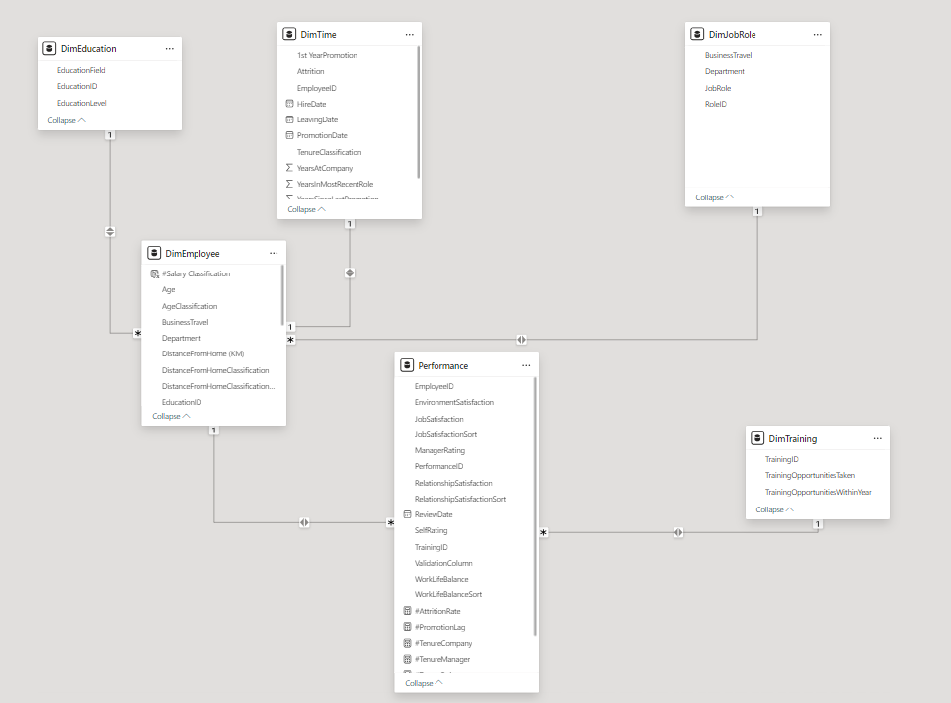

Slide 10

Let’s open Power BI

Slide 11
Unique Value Proposition
Our dashboard uniquely integrates performance, demographic, and behavioral data to provide HR professionals with a 360° view of the workforce.
Key benefits include:
Compare current vs. former employees across various dimensions.
Correlate overtime, manager ratings, and travel frequency with attrition.
Segment employees by salary levels, stock options, and work tenures.

Slide 12

Our insights

Slide 13
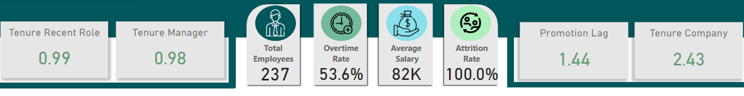
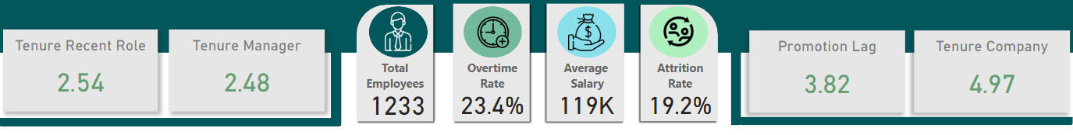
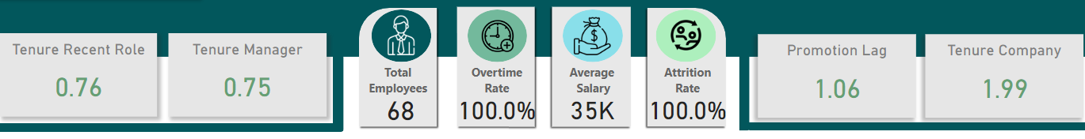
Top Attrition Drivers
Overtime
53.6% attrition rate for overtime workers vs. 23.4% for others
53.5% of overtime leavers had below-average salaries
Key Insight: Overtime + low pay = high attrition risk

Slide 14
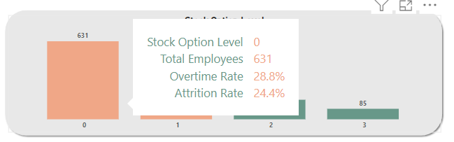
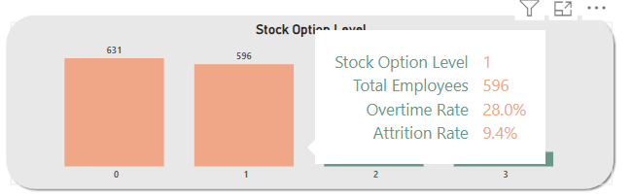
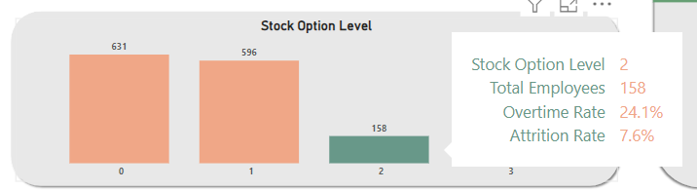
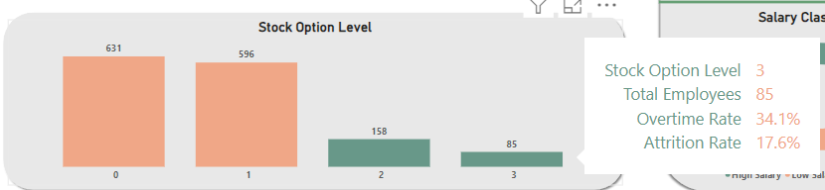
2. Stock Options
Attrition rates: Level 0 = 24.4%, Level 3 = 17.6% (with 66% overtime)
Best retention: Level 2 = 7.6%
Key Insight: Stock options reduce attrition, unless offset by overtime

Slide 15
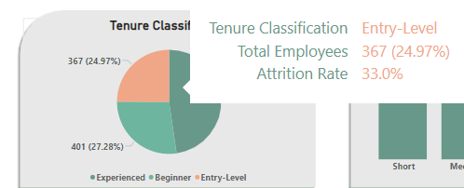
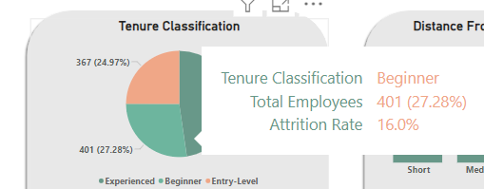
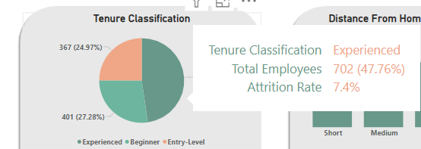
3. Tenure
Entry-level: 33% attrition vs. Experienced: 7.4%
Key Insight: Newer employees are at highest risk

Slide 16
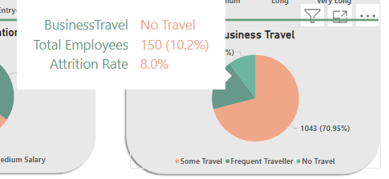
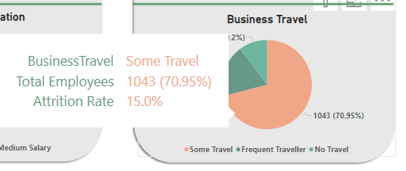
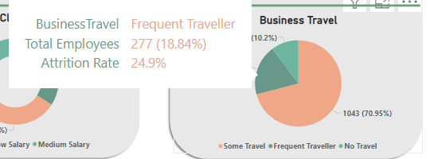
4. Business Travel
No travel = 8%, Some = 15%, Frequent = 24.9%
Key Insight: More travel = more attrition

Slide 17
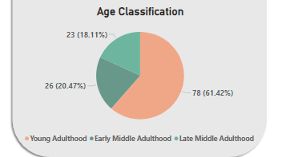
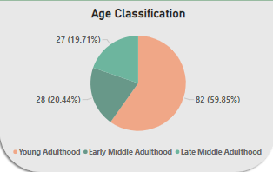
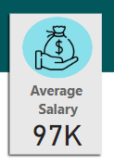
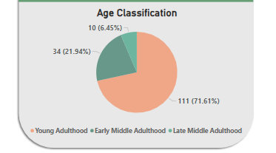
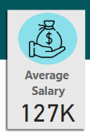
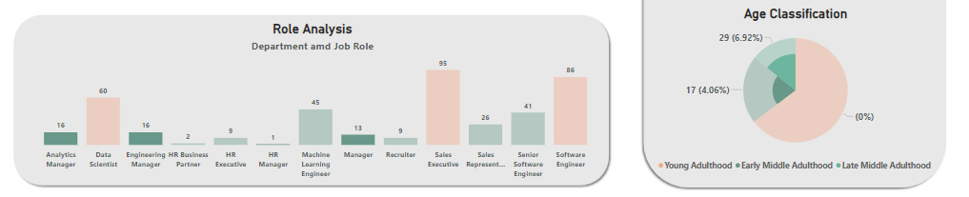
Attrition Risks
5. Age & Career
Growth2022: 72% of hires = young adults, 0 hired as managers
Salary dropped from $127K (2021) to $97K (2022)
Key Insight: Younger employees face growth & pay limitations

Slide 18
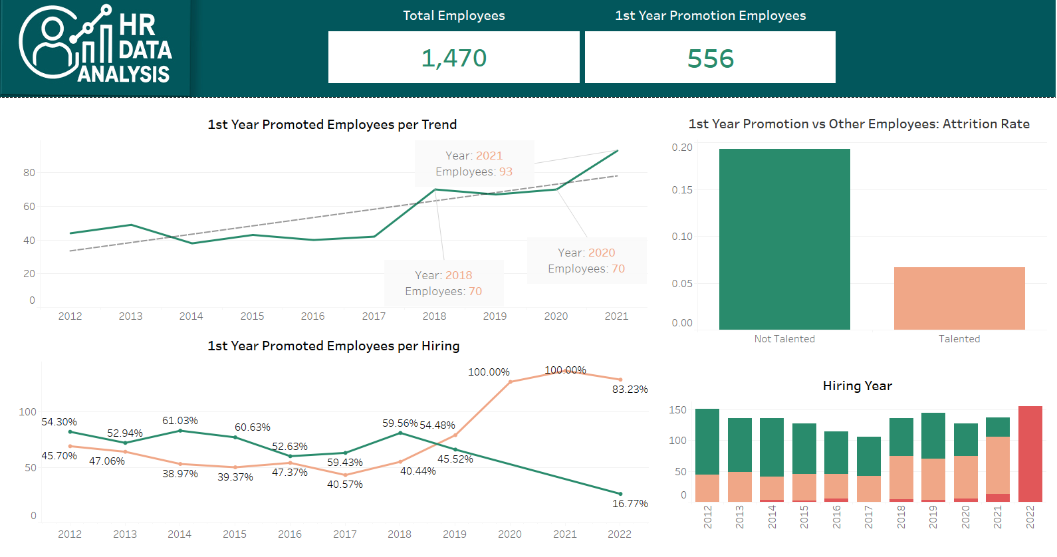
6. Diversity
2020–21 hires = 100% white, 2022 = 83.2% white
Key Insight: Low diversity may impact inclusion and retention

Slide 19
7. First-Year Promotions
55% of hires got first-year promotions
Key Insight: Early promotion boosts retention

Slide 20

Recommendations

Slide 21
Review Overtime Policies
Minimize excessive overtime, especially for lower-paid employees, to reduce burnout and turnover.
Improve Compensation and Benefits
Adjust salary structures and stock option plans to enhance retention across all employee levels.
Strengthen Onboarding and Entry-Level Support
Implement mentorship and development programs to increase engagement among new hires.
Reevaluate Business Travel Requirements
Reduce frequent travel for roles with high attrition risk to improve work-life balance.

Slide 22
Support Early Career Advancement
Continue promoting high-performing employees in their first year to boost motivation and loyalty.
Create Clear Growth Paths for Young Talent
Establish transparent promotion opportunities to retain younger employees and avoid career stagnation.
Promote Diversity in Hiring
Adopt inclusive recruitment strategies to build a more diverse and representative workforce.
Ensure Pay Equity Over Time
Monitor internal salary fairness to prevent dissatisfaction among employees hired during different periods

Slide 23


